Slide 1
INFORMATION SYSTEMS SECURITY, CONTROL AND AUDIT
Information Systems Security
ACCESS CONTROLS AND SECURITY OPERATION AND ADMINISTRATION
Week 5

Slide 2
Four Parts of Access Control (Authorization, Identification, Authentication, Accountability).
Physical/Logical Access Control
Authorization Policy
Authentication Processes and Requirements (Knowledge, Ownership, Characteristics)
Accountability Policies & Procedures
Formal Models of Access Control
Threats to Access Controls
Centralized and Decentralized Access Control

Slide 3
Four Parts of Access Control
Authorization – who is approved for access and what, exactly, can they use?
Identification – How are the identified?
Authentication – Can their identities be verified?
Accountability – How are actions traced to an individual to ensure that the person who makes changes to data or systems can be identified.
Notes:
Access controls are methods used to restrict and allow access to certain items, such as automobiles, homes, computers.
Access control is the process of protecting a resource so that it is used only by those allowed to use it. Access control protects a resource from unauthorised use.

Slide 4

ATM WITHDRAWAL PROCESS
Authorization
Identification
Authentication
Accountability

Slide 5
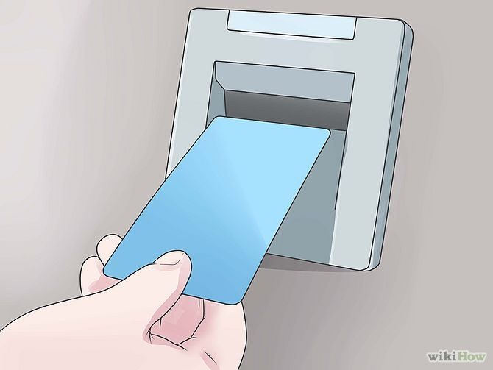
ATM WITHDRAWAL PROCESS
Authorization
Identification
Authentication
Accountability

Slide 6
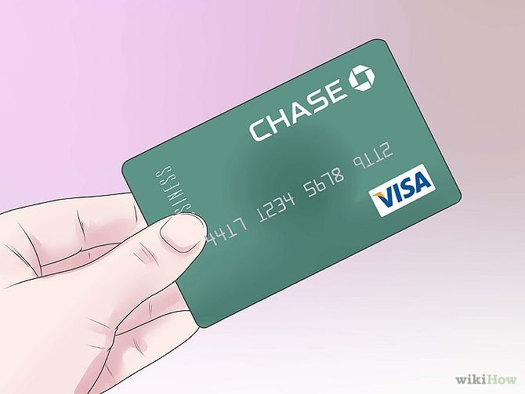
ATM WITHDRAWAL PROCESS
Authorization
Identification
Authentication
Accountability

Slide 7
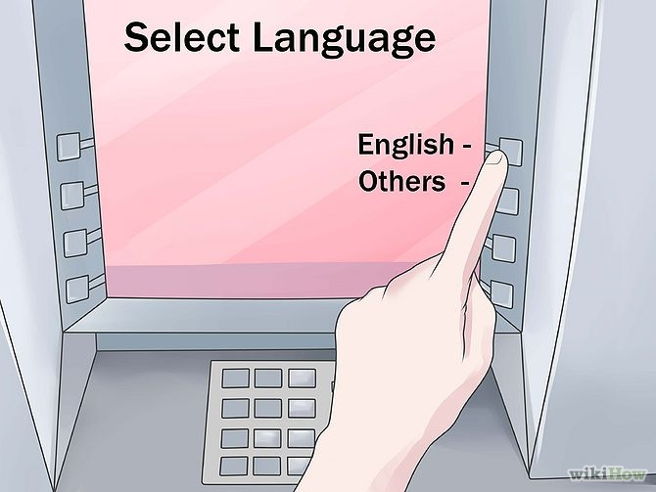
ATM WITHDRAWAL PROCESS
Authorization
Identification
Authentication
Accountability

Slide 8
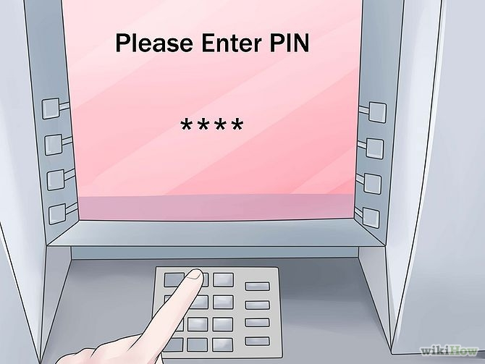
ATM WITHDRAWAL PROCESS
Authorization
Identification
Authentication
Accountability

Slide 9
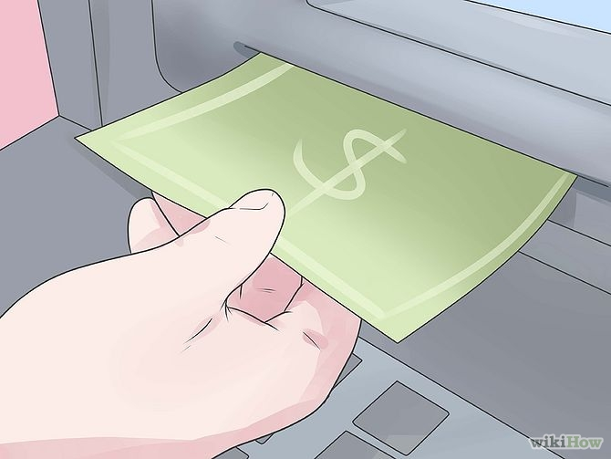
ATM WITHDRAWAL PROCESS
Authentication
Authorization
Identification
Accountability

Slide 10
Types of Access Control
Physical Access Controls – These control entry into buildings, parking lots, and protected areas
Logical Access Controls – Control access to a computer system or network. Use of unique username and password to log into a company computer is an example of logical access control

Slide 11
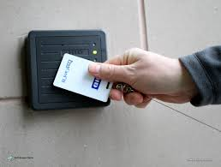
Physical Access Control
A company may give you a security card (Smart card) programmed with your employee ID number.
You will swipe this card through a card reader to open a gate to the parking lot of swipe it in the elevator to be let off on your floor.

Slide 12
Logical Access Control
Logical Access Controls are primarily used to
Decide which users can get into a system – In a SAP system storekeepers will be restricted to the Store Keeping Module and not allowed to access the Procurement Module
Monitoring what the user does on the system – Auditors are only allowed to View databases and not Create, Edit or Delete
Restraining of influencing the user’s behaviour – repeated attempts to access restricted/prohibited information will result in denial e.g. WebMarshal

Slide 13
The Security Kernel
The security kernel is the central part of a computing environment. It enforces access control for computer systems.
The security kernel provides a central point of access control and implements the reference monitor concept.
A reference monitor is software that provides a central point of processing for all resource access requests.
How does it work?

Slide 14
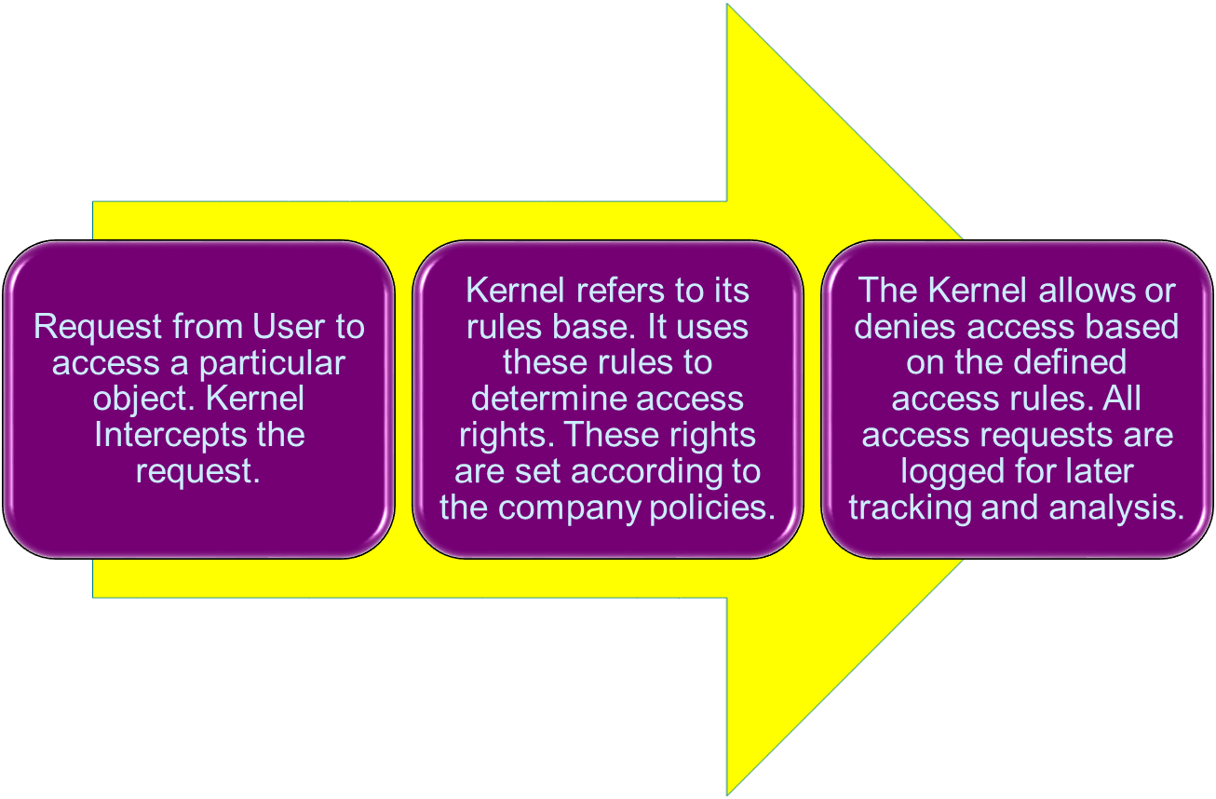
Security Kernel Reference Monitor

Slide 15
Access Control Policies
Access Control Policies are deliverables of any CIO/Information Security Manager
There are four central elements of access to make the access control policies effective
Users
Resources – protected objects in the system
Actions – activities that authorised users can perform
Relationships – optional conditions that exist between users and resources e.g. read, delete, write, execute etc.

Slide 16
PARTS OF ACCESS CONTROL
Authorization – who is approved for access and what, exactly, can they use?
Identification – How are they identified?
Authentication – Can their identities be verified?
Accountability – How are actions traced to an individual to ensure that the person who makes changes to data or systems can be identified.

Slide 17
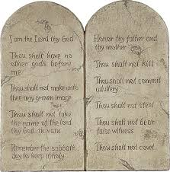
Authorization Policy
The first step in enforcing access control is creating the Access Control Policy that will define authorization rules.
Authorization

Slide 18
Authorization Policy
Authorization is based on job roles, background screening, government requirements etc..
An Authorization Policy includes a Group Membership Policy and an Authority Level Policy.
In Group Membership Policy authorization is defined by what group you are in. Group allocation is derived from job description e.g. door access card for lecturer would not be able to open the server room door.
In Authority Level Policy the user with higher authority can access the server room with his/her smart card.
Authorization

Slide 19
Authorization Policy
Enforcing the Authorization Policy is done through identification methods.
Identification is the method a subject uses to request access to a system or resource.
To be able to identify subjects various methods can be used e.g.
Username (userID, account number, PIN, smart card)
Biometrics
Which others do you know
Authorization\Identification

Slide 20
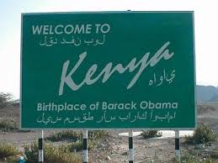
AUTHENTICATION – VERY CRITICAL
Authentication – Can their identities be verified?
Authentication answers the question: Are you who you say you are?
It proves that the subject requesting access is the same subject who has been granted access.
Authorization\Identification

Slide 21
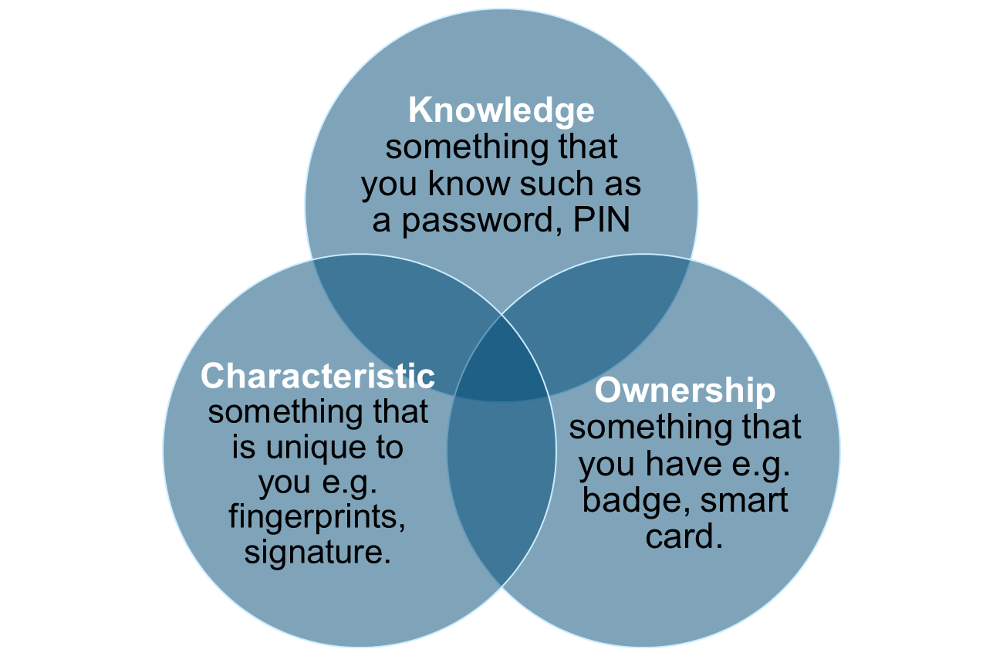
Authentication Types
Authorization\Identification

Slide 22
Authentication Types
Golden Rule: As the value of resources increases, so should the strength of the access controls protecting it.
Single-Factor Authentication: Use of controls from only one category.
Two-Factor Authentication: User of techniques from two or more of these techniques.
Authentication

Slide 23
Knowledge something that you know such as a password, PIN
Authentication

Slide 24
Authentication By KNOWLEDGE
Authentication by Knowledge is based on something you know, such as a password, passphrase, or PIN. Passwords are the oldest and most common method of authentication for computer systems. They are also the weakest.
Authentication

Slide 25
Authentication By KNOWLEDGE
Some password best practices are adequate but experience has shown that sharing of passwords is the most infringed upon policy in companies.
Using a passphrase is considered more secure. Although passphrases are static, they aren’t as susceptible to brute-force attacks as passwords.
Authentication

Slide 26
Ownership something that you have e.g. badge, token, smart card.
Authentication

Slide 27
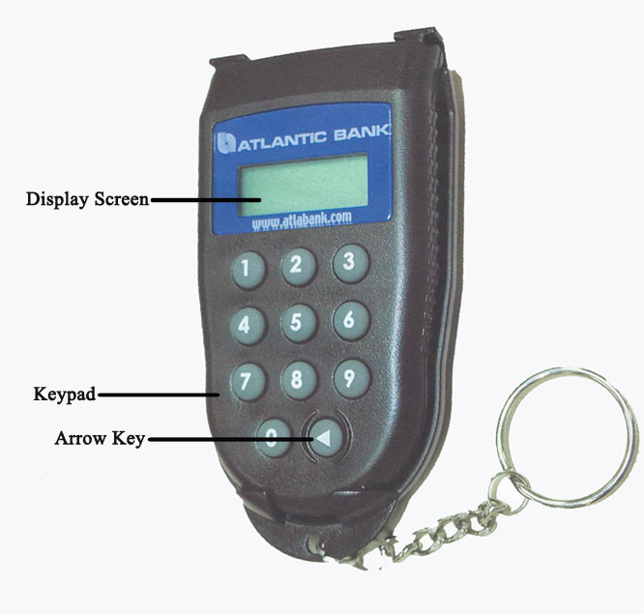
Authentication By OWNERSHIP
Authentication by Ownership is based on something you have, such as a smart card, a key, a badge, or a token.
Authentication

Slide 28
OWNERSHIP - Synchronous Token
A synchronous token uses an algorithm that calculates a number at both authentication server and the device.
It displays the number on the device’s screen.
The user enters this number as a logon authenticator, just as he or she would use a password.
Authentication

Slide 29
OWNERSHIP - Synchronous Token
Types of Synchronous tokens:
Time - Based: uses current time as the input value. It then generates a password.
Event - Based: It increases the value of the counter with each use. This value is then used as the input value on the workstation.
Continuous: use of proximity cards that continuously communicate with the access system. If the users walks away from the range of the detector the system locks the server/desktop.
Authentication

Slide 30
OWNERSHIP - Asynchronous Token
Looks like a credit-card sized calculator.
The authentication server issues a challenge number that the user enters.
The token computes a response to the value provided by the authentication server.
The user then replies to the server with the value displayed on the token.
Asynchronous Tokens also protect the token from misuse by requiring the user to enter a PIN along with the initial challenge value.
Authentication

Slide 31
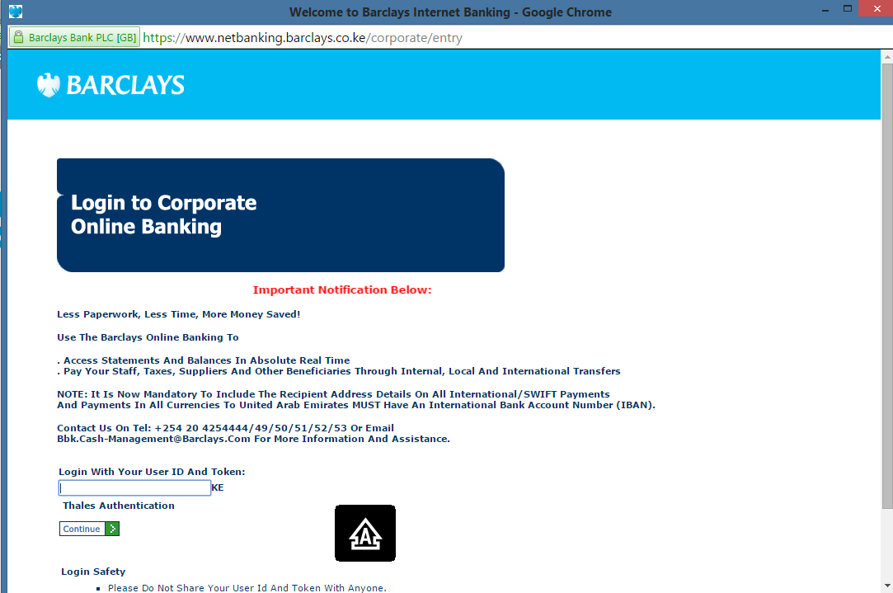
OWNERSHIP - Asynchronous Token
https://www.netbanking.barclays.co.ke/corporate/CorporateLogin.html
Authentication

Slide 32
Characteristic (Biometric)
something that is unique to you e.g. fingerprints, signature.
Authentication

Slide 33
Characteristics/Biometrics
Biometrics can be used for both identification and authentication.
Biometrics involves measuring various unique parts of a person’s anatomy or physical activities.
The two main Biometric Categories are:
Authentication

Slide 34
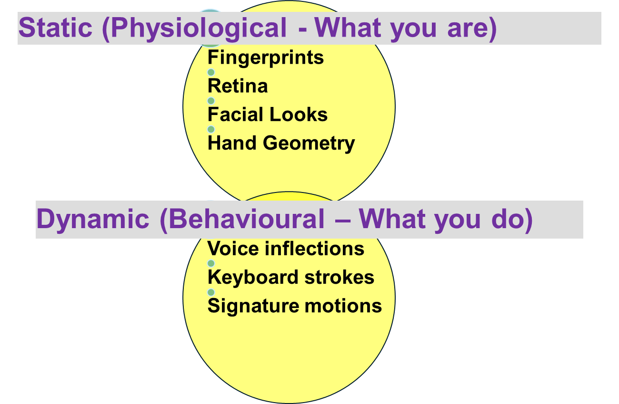
Characteristic/Biometric Main Categories
Authentication

Slide 35
Types of Biometrics
Fingerprint (Physiological/Behavioural?)
Palm Print (Physiological/Behavioural?)
Hand Geometry (Physiological/Behavioural?)
Retina Scan (Physiological/Behavioural?)
Iris Scan (Physiological/Behavioural?)
Facial Recognition (Physiological/Behavioural?)
Voice Pattern (Physiological/Behavioural?)
Keystroke Dynamics (Physiological/Behavioural?)
Signature Dynamics (Physiological/Behavioural?)
Authentication

Slide 36
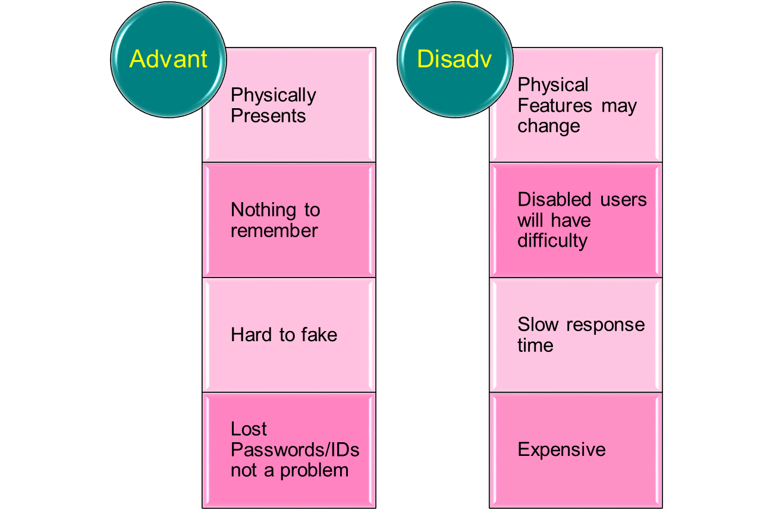
Advantages/Disadvantages of Biometrics
Authentication

Slide 37
Single Sign-On (SSO)
A Single Sign-On (SSO) strategy allows users to sign on to a computer or network once and have their identification and authorization credentials allow them into all computers and systems where they are authorized.
Advantages:
It’s an efficient logon process.
It can provide for stronger passwords.
It provides continuous, clear re-authentication
Disadvantages
A compromised password lets an intruder into all areas open to the password owner
Authentication server can become a single point of failure for system access
Authentication

Slide 38
Kerberos
Kereberos is a computer-network authentication protocol that allows nodes communicating over a non-secure network to prove their identity to one another in a secure manner.
Kereberos is aimed at a client/server model, and it provides mutual authentication – both the user and the server verify each other’s identity.
Authentication

Slide 39
Accountability
Accountability – How are actions traced to an individual to ensure that the person who makes changes to data or systems can be identified.
Accountability Sources
Log files - are a key ingredient. Log files are records that detail who logged in to the system, when they logged in, and what information or resources the used.
Data Retention, Media Disposal & Compliance Requirements
Procedures
Accountability

Slide 40
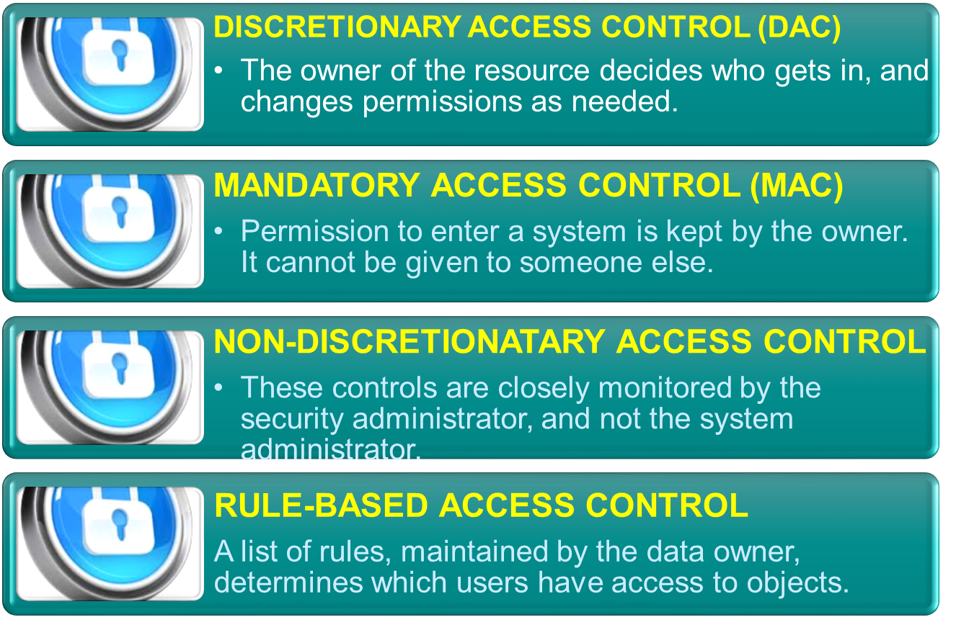
Formal Models of Access Controls

Slide 41
Rule Based - Access Control Lists
Operating systems provide several options to associate lists or permissions with objects. These lists are called Access Control Lists (ACLs).
Linux & Mac OS have read, write and execute permissions.
These can be applied to file owners, groups, or global users
Windows has both share permissions and security permissions, both of which enable ACLs to define access rules.

Slide 42
How ACLs work in Routers
A router acts as a packet filter when it forwards or denies packets according to filtering rules. As a Layer 3 device, a packet-filtering router uses rules to determine whether to permit or deny traffic based on source and destination IP addresses, source port and destination port, and the protocol of the packet. These rules are defined using access control lists or ACLs.
To simplify how ACL or a router uses packet filtering work, imagine a guard stationed at a locked door. The guard's instruction is to allow only people whose names appear on a quest list to pass through the door. The guard is filtering people based on the condition of having their names on the authorized list.

Slide 43
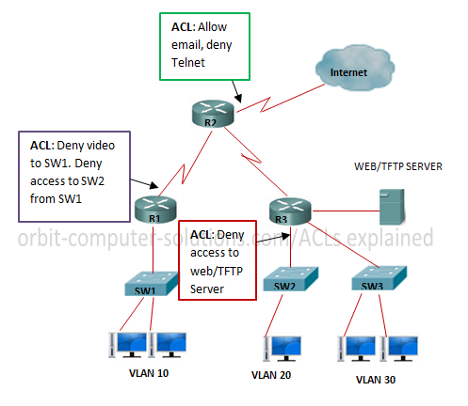

Slide 44
Separation of Duties
Is the process of dividing a task into a series of unique activities performed by different people, each of whom is allowed to execute only one of the part of the overall task.
This principle prevents people from both creating and approving their own work. Separation of duties can be a valuable tool to prevent fraud or errors by requiring the cooperation of another person to complete a task e.g. nuclear submarine nuclear missile system that requires the Captain and Weapons Engineering Officer.

Slide 45
Read about Centralized and Decentralized Access Control

Slide 46
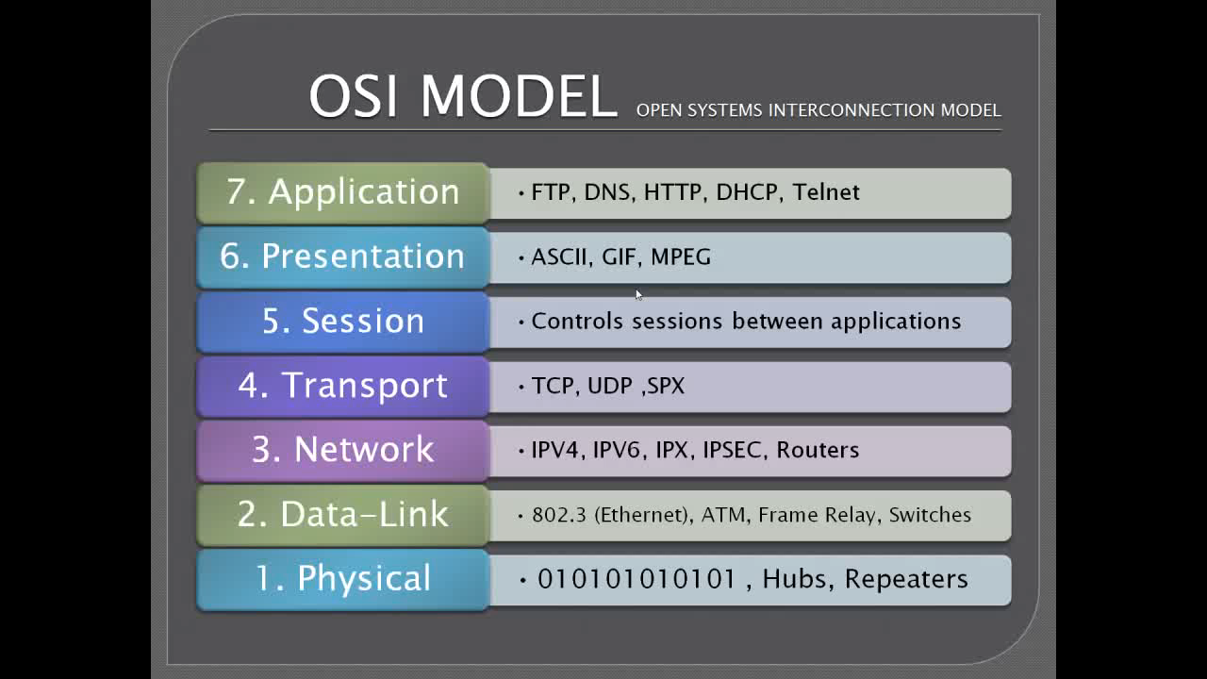
OSI MODEL

Slide 47
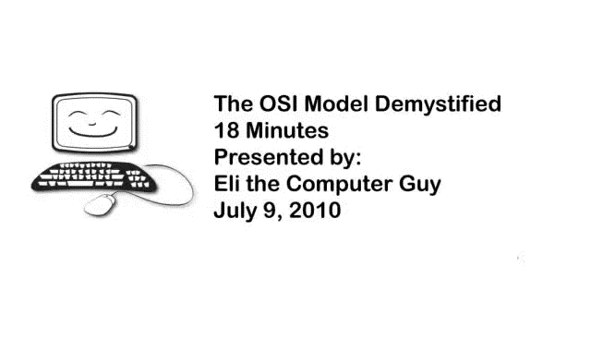
OSI MODEL DEMYSTIFIED

